Slide 1


Statistical Modelling with Data
May 23 – June 02, 2023
Instructor: Qing (Leah) Li, Ph.D. Candidate at Cumming School of Medicine
qing.li2@uclagary.ca
Thank you Dr. Thuntida Ngamkham for contributing the contents
Thank you Dr. Qingrun Zhang and Dr. Quan Long for contributing some slides

Slide 2
Statistical Modelling with Data
Topic 1: Statistical Modelling
Lecture 1: First-order models with quantitative independent variables
Topic 2: Statistical Modelling with interactions (Assignment 1)
Lecture 2: Interaction effects, quantitative and qualitative variables
Lecture 3: Interaction effects and second-order models
Topic 3: Statistical Model selection (Assignment 2)
Lecture 4: Model selection: Stepwise regression procedures
Lecture 5: Model selection: Forward and Backward selection procedures
Topic 4: Statistical model diagnostics
Lecture 6: Multiple regression diagnostics: verify linearity, independence, and equal variance assumptions.
Lecture 7: Multiple regression diagnostics: verify normality assumptions and identify multicollinearity and outliers.
Lecture 8: Multiple regression diagnostics: data transformation
Topic 5: Transfer learning
Lecture 9: Transfer-learning (Bonus): standing on the shoulders of giants.
Notes:
Overview of the section 2, Statistical Modeling with Data, I will walk you through many valuable statistical modelling techniques and methods, including model building, model selection, model evaluations, etc. In addition, I also prepared one lecture about transfer learning which is based on one of my research projects. Let's take a closer look at deep learning models, and explore some examples of transfer learning using the power of already-built models to solve in-house problems better and cheaper.

Slide 3
Statistical Modelling with Data
Topic 1: Statistical Modelling
Lecture 1: First-order models with quantitative independent variables
Topic 2: Statistical Modelling with interactions (Assignment 1)
Lecture 2: Interaction effects, quantitative and qualitative variables
Lecture 3: Interaction effects and second-order models
Topic 3: Statistical Model selection (Assignment 2)
Lecture 4: Model selection: Stepwise regression procedures
Lecture 5: Model selection: Forward and Backward selection procedures
Topic 4: Statistical model diagnostics
Lecture 6: Multiple regression diagnostics: verify linearity, independence, and equal variance assumptions.
Lecture 7: Multiple regression diagnostics: verify normality assumptions and identify multicollinearity and outliers.
Lecture 8: Multiple regression diagnostics: data transformation
Topic 5: Transfer learning
Lecture 9: Transfer-learning (Bonus): standing on the shoulders of giants.

Slide 4
Statistical Modelling with Data
Learning Outcomes: At the end of the course, participants will be able to
Model the multiple linear relationships between a response variable (Y) and all explanatory variables (both categorical and numerical variables) with interaction terms. Interpret model parameter estimates, construct confidence intervals for regression coefficients, evaluate model fits, and visualize correlations between a response variable (Y) and all explanatory variables (X) by graphs (scatter plot, residual plot) to assess model validity.
Predict the response variable at a certain level of the explanatory variables once the fit model exists.
Implement R-software and analyze statistical results for biomedical and other data.
Evaluations
Assignments will be posted on Slack (our communication tool with students).
Students must attend 70% (6/9) of the sessions in order to receive the certificate and are encouraged to work on the assignments progressively throughout the course as the relevant material is covered.

Slide 5

Statistical Modelling with Data
Supportive materials
Lectures slides (2023)
R code scripts (2023)
PDF (dated 2022)
Two Assignments (dated 2022)
Slack channels
Recoding videos
Exercises
Course-documents
Notes:
All of the code in the presentations may be found as R code scripts. These R scripts contain code for in-class practice as well. However, I would advise you to think about these in-class problems first and write down your responses. Then, compare your answers to the reference answers. This helps you understand the problem and write R code.
I will walk you through in class practice problems in details. The assignments are not mandatory and just for your fun. If you are bored and want to do something, you are welcomed to conquer these problems. Again, these assignments are not required to obtain the certificate. To get the certificate, you only need to show up in 6 of 9 courses.
I do have answers for these assignments and please email me if you need answers for this assignment.

Slide 6
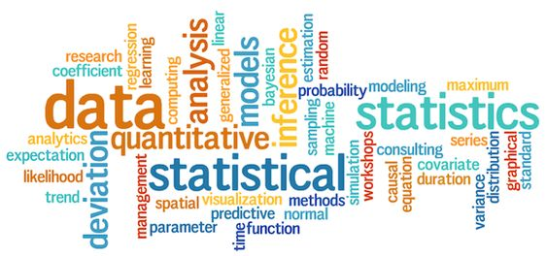
Motivations of your statistical modelling
Notes:
What motivated you to learn statistical modelling?

Slide 7

Lecture 1: Multiple Linear Regression First-order models with quantitative independent variables

Slide 8
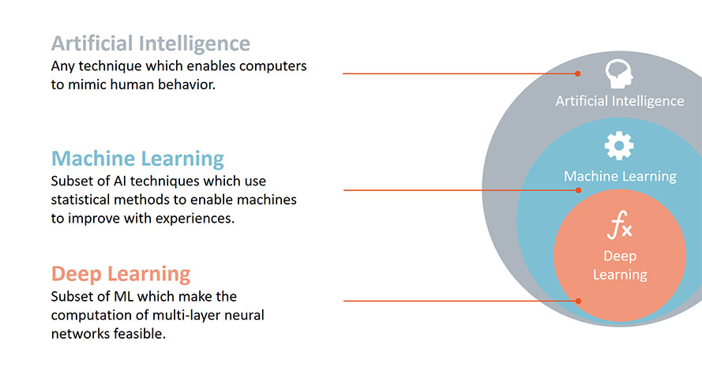
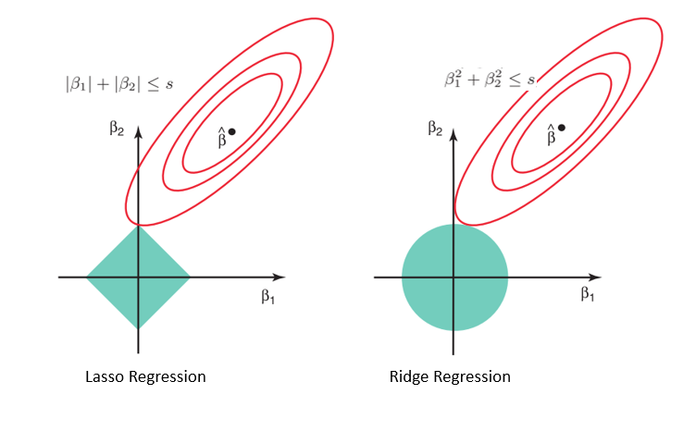
What is a statistical model?
A statistical model describes how a dependent variable (Y) is thought to have been generated.
Parameter estimation is the process of computing a model's parameter values from measured data.

Slide 9
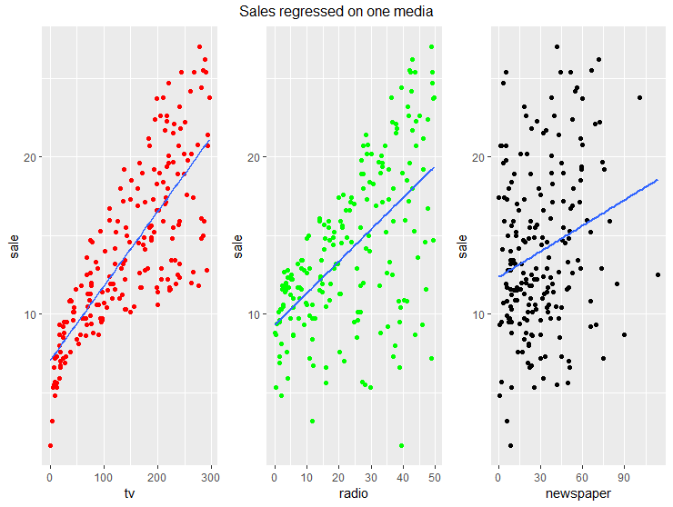
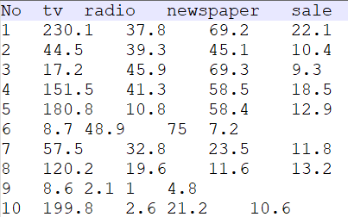









Simple linear model
Sales (in thousands of units)
Budgets(in thousands of dollars)
Which factor affects sales most?
It seems advertainment budget through TV has a great impact on sales
sales ~ Newspaper advertisement budget
sales ~ TV advertisement budget
sales ~ Radio advertisement budget
Notes:
Let’s kick off this course with a toy example. Imagine we are working in a car company and our boss wants to improve the sales of cars. He asked last year’s best salesman Peter to come up with ideas. It’s big task however Peter knows that sales are closely linked to the advertisement. So, he knows that TV, RADIO, NEWSPAPERS are the three major way of advertising in his company. So he checked last year’s advertisement budgets from three media and sales incomes from 200 different markets.
Sales (in thousands of units)
Budgets(in thousands of dollars)
Don't fool me with figures!

Slide 10
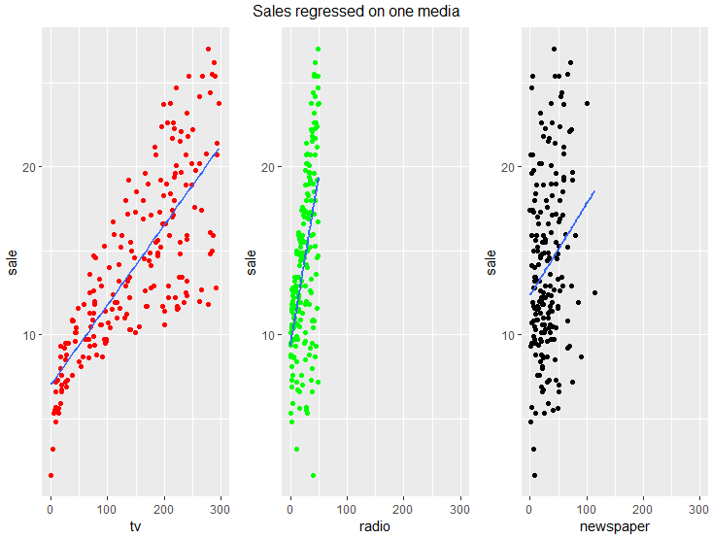
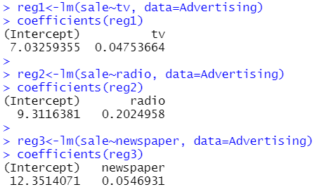
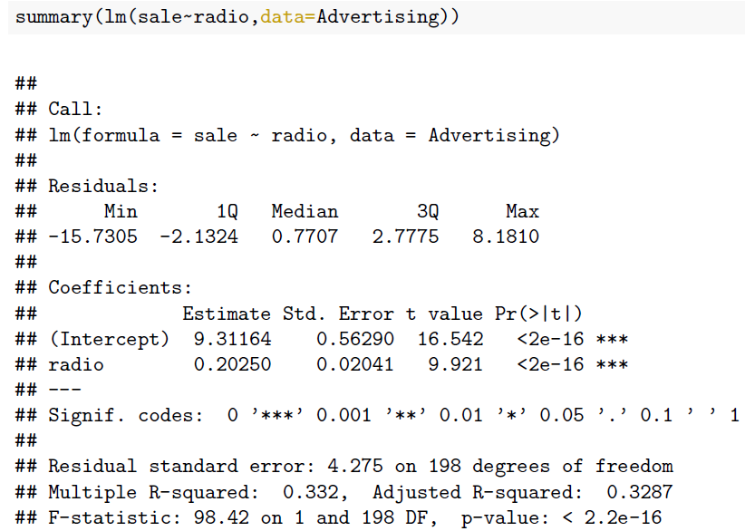
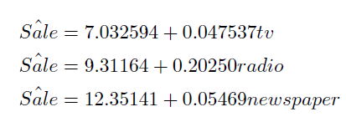
Simple linear model
It’s so easy! Wait a bit! Can TV and radio jointly affect sales?

Slide 11
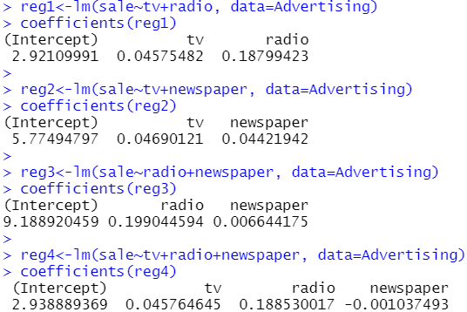
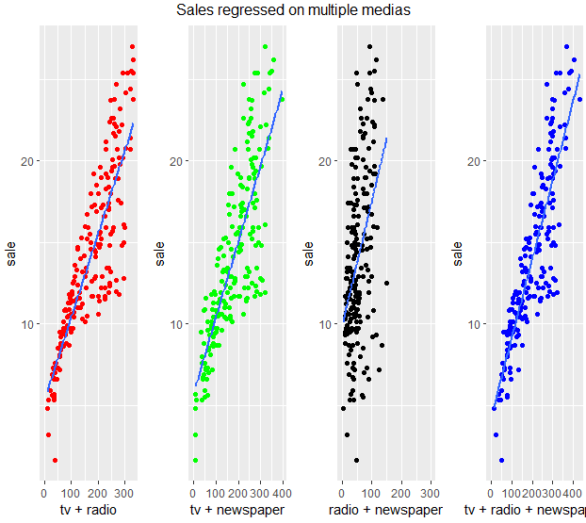
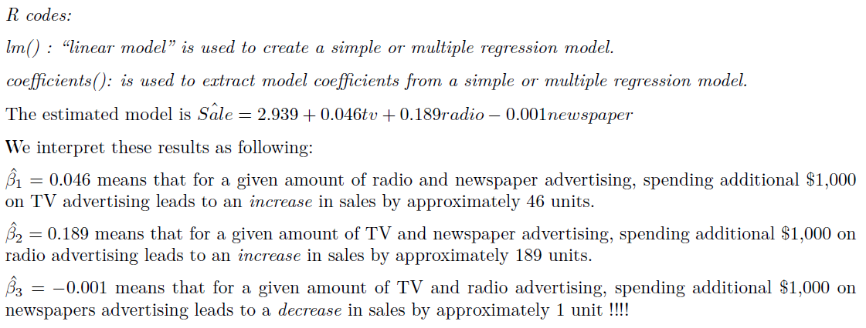
Multiple linear model
Radio advertainment budget has the largest impact on sales

Slide 12
General linear model
Statistics:
1. continuous dependent variable ~ continuous independent variables (one/multiple)
2. Pay attention to variables unit and scales
R code:
lm(y~x)
Coefficients(lm(y~x))
summary (lm(y~x))
ggplot: https://ggplot2.tidyverse.org/
ggplot() : is used to construct the initial scatter plot.
geom_point(): the point geom is used to create scatterplots.
geom_smooth() : aids the eye in seeing patterns in the presence of overplotting.

Slide 13
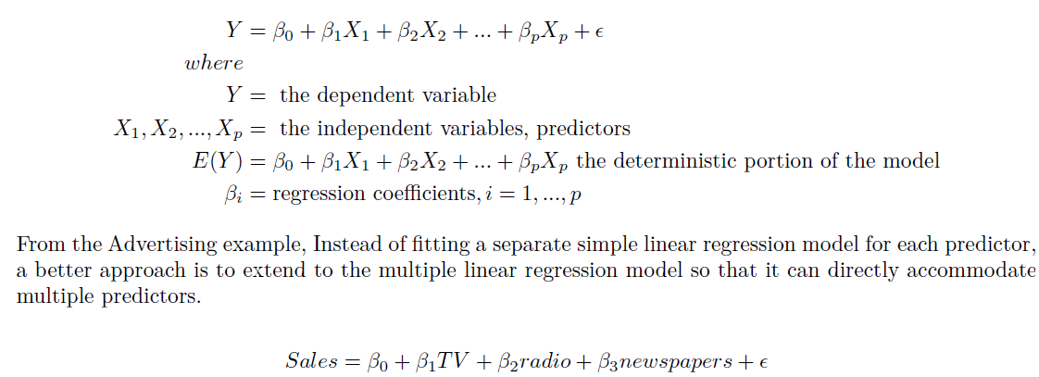
A little bit mathematics
General linear regression model, also called first-order model as it contains variables in first order format (in contrast to second order, third order, …)

Slide 14
General linear model
Simple linear regression is used to model the relationship between two continuous variables. Often, the objective is to predict the value of an output variable (or response) based on the value of an input (or predictor) variable.
Multiple linear model is a regression model involving two or more independent variables.
Simple linear regression and multiple linear regression model are general linear model. The term "general" linear model (GLM) usually refers to conventional linear regression models for a continuous response variable given continuous and/or categorical predictors.

Slide 15
Limitations of the general linear models
Linear models assume that
Y (generally) follows normal distribution
And the Xs impact Y in a linear manner
This may be wrong if
Y is category (yes or no)
Y is a proportion of something
…
So we need something more general

Slide 16
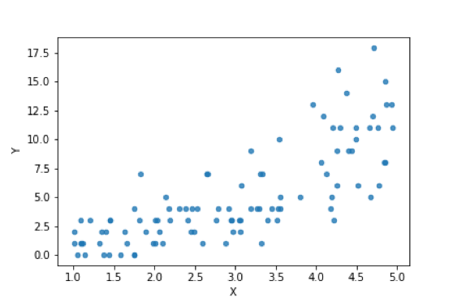
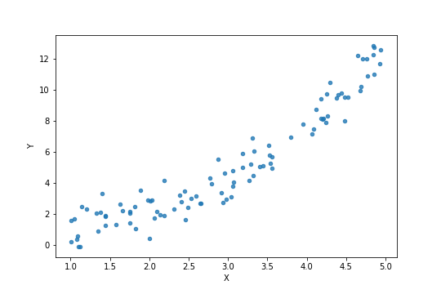
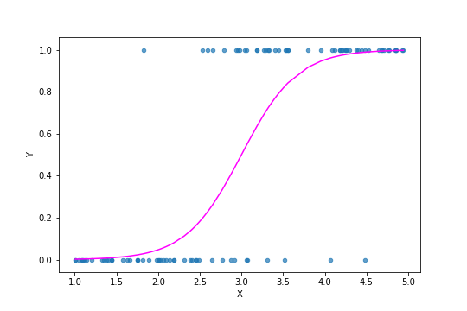
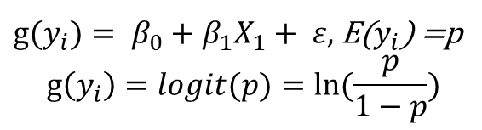
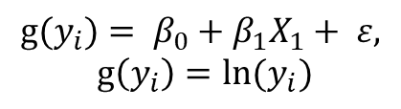
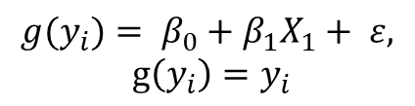
Limitations of the general linear models
$$g(y_{i})= β_{0}+β_{1}X_{1}+ ε,$$
$$g\left(y_{i}\right)=y_{i}$$
$${g⁡(y}_{i})= β_{0}+β_{1}X_{1}+ ε,$$
$$g\left(y_{i}\right)={ln⁡(y}_{i})$$
${g⁡(y}_{i})= β_{0}+β_{1}X_{1}+ ε,$E($y_{i}$) =p
$$g\left(y_{i}\right)=logit(p)=ln⁡(\frac{p}{1−p})$$

Slide 17
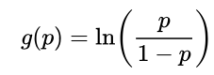
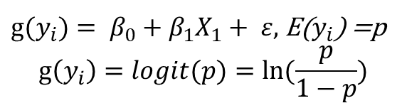
Generalized linear model
The response, Y, follows something not normal, precisely, an exponential family.
Again, like the case of linear model, a set of Xs forming a linear predictor Σβ_{i}X_{i}
Linking function: The relationship between the linear predictor and the mean of the distribution (that Y supposed to follow). For instance, logistic regression.
“glm”: for generalized linear regression
${g(y}_{i})= β_{0}+β_{1}X_{1}+ ε,$E($y_{i}$) =p
$$g\left(y_{i}\right)=logit(p)=ln⁡(\frac{p}{1−p})$$
Notes:
The natural logarithm of a number is its logarithm to the base of the mathematical constant e, which approximately equal to 2.718281828459.

Slide 18
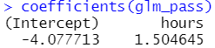
An example for generalized linear model
hours=c(0.50,0.75,1.00,1.25,1.50,1.75,1.75,2.00,2.25,2.50,2.75,3.00,3.25,3.50,4.00,4.25,4.50,4.75,5.00,5.50)
pass=c(0,0,0,0,0,0,1,0,1,0,1,0,1,0,1,1,1,1,1,1)
glm_pass=glm(pass~hours, family=binomial(link='logit'))
P(passing the exam) = 1/(1+exp(-(1.50 *hours -4.08)))

Slide 19
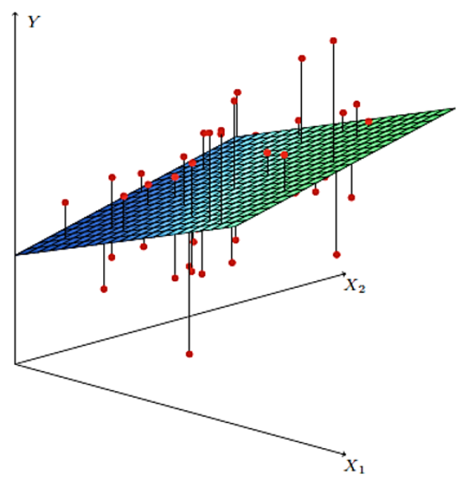
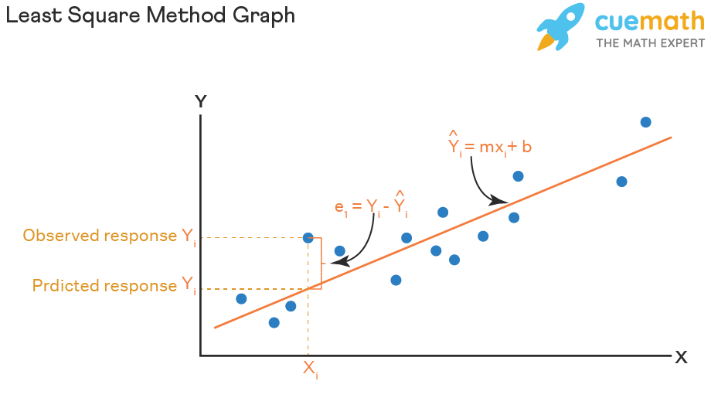
Least square method
The least squares method is a statistical procedure to find the best fit for a set of data points by minimizing the sum of the offsets or residuals of points from the plotted curve.
Parameter estimation is the process of computing a model’s parameter values from measured data.
Least square line
Notes:
We cannot guarantee that Yi – Yi’ are always positive, so in reality, we minimize squares of Yi-Yi’

Slide 20
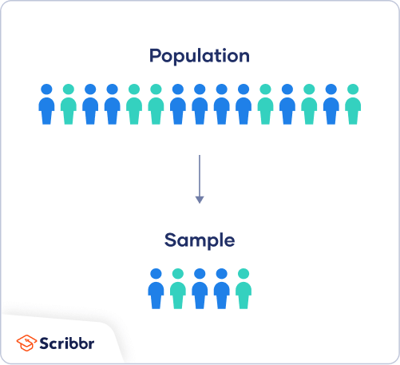
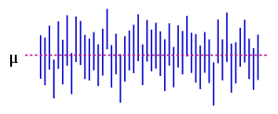
Confidence interval
Is the estimated value equals to actual value?
Can we find an interval where the actual value is in?
Confidence interval (CI) refers to a range of values within which statisticians believe the actual value of a certain population parameter lies.
95% confidence interval for a given parameter: if we conduct 100 tests, in 95 tests, our calculated interval contain the actual value. However, in the rest 5 tests, our calculated intervals do not contain the actual value.
The confidence interval is based on the observations from a test, and hence differs from test to test.
We cannot say “with probability (1 − α), the parameter μ lies in the confidence interval.” Because once the CI is calculated, the actual value is either in the CI or not.
In real life, statisticians often have limited number of tests. With 95% CI, analysts think they have a good chance of including the real number.
The figure on the right shows 50 realizations of a confidence interval [can be long or short] for a given population mean μ. 95% confidence interval for mu requires 100 realizations, 95 realizations CI contains true mu and 5 not.

Slide 21
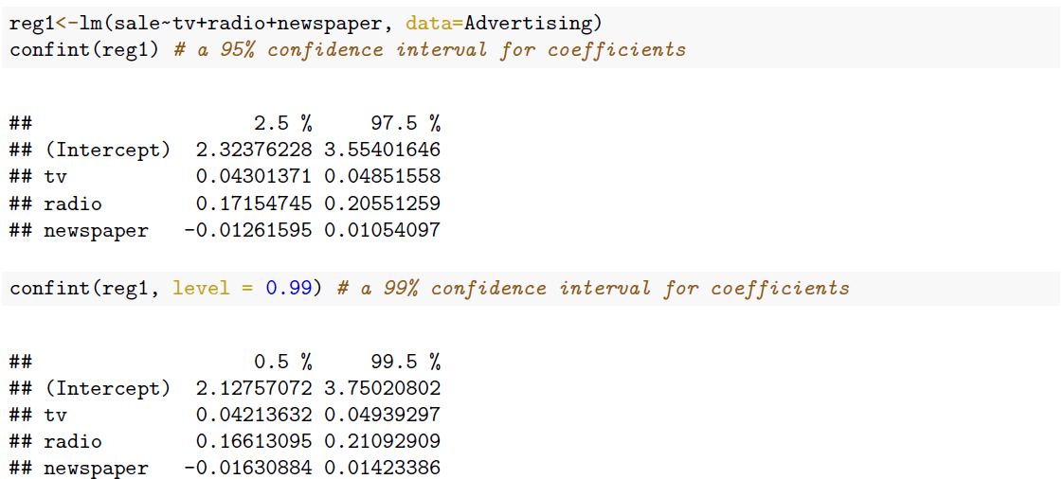
Confidence interval

Slide 22

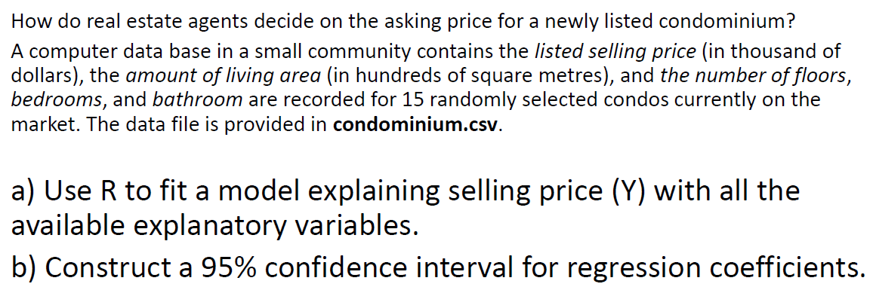

In class Practice Problem 1
L1.R

Slide 23

Coffee break Come back at 14:40pm?

Slide 24
Models Evaluations
1. Is this multiple regression model any good at all? Is at least one of the predictors useful in predicting the response?
2. Do all the predictors help to explain Y , or is only a subset of the predictors useful?
Notes:
The answer is that we can test some hypotheses to see the relationship between the response and predictors. To
address the overall question, we will test

Slide 25
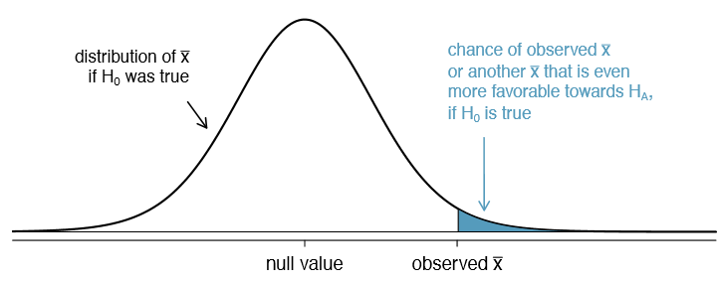
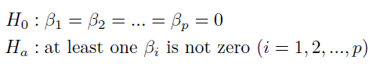
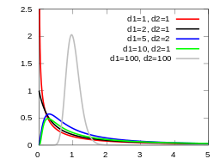
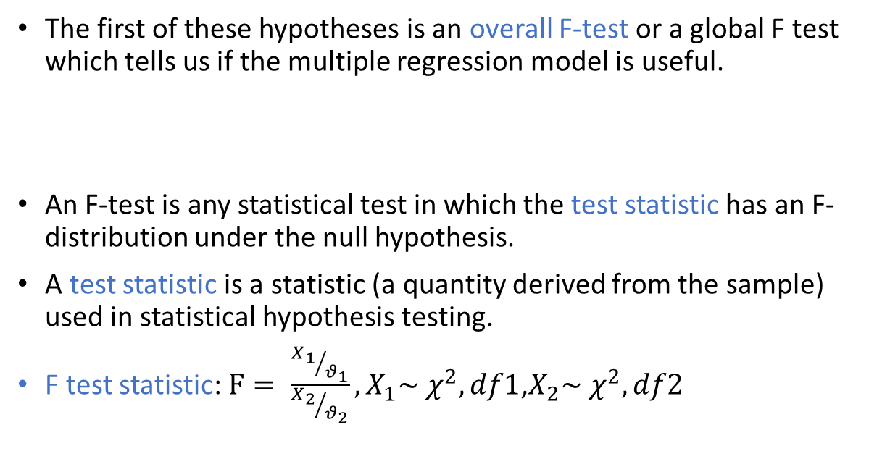
Evaluating Overall Model Utility
1. Is this multiple regression model any good at all? Is at least one of the predictors useful in predicting the response?
The first of these hypotheses is an overall F-test or a global F test which tells us if the multiple regression model is useful.
An F-test is any statistical test in which the test statistic has an F-distribution under the null hypothesis.
A test statistic is a statistic (a quantity derived from the sample) used in statistical hypothesis testing.
F test statistic: $F= \frac{{X_{1}}/{θ_{1}}}{{X_{2}}/{θ_{2}}},X_{1}\sim χ^{2}, df1$,$X_{2}\sim χ^{2}, df2$
Notes:
f-distribution is the ratio of the X1 random chi-square variable with degrees of freedom ϑ1 and the X2 random chi-square variable with degrees of freedom ϑ2. In other words, each Chi-Square random variable has been divided by its degrees of freedom.
[https://sixsigmastudyguide.com/f-distributionf-statistic-f-test/]

Slide 26
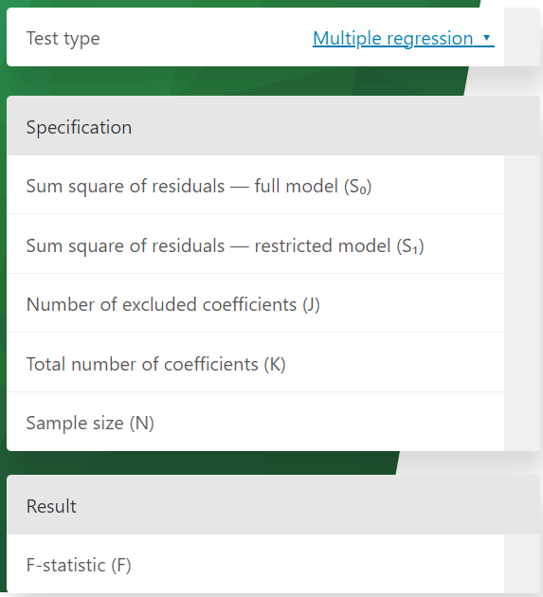
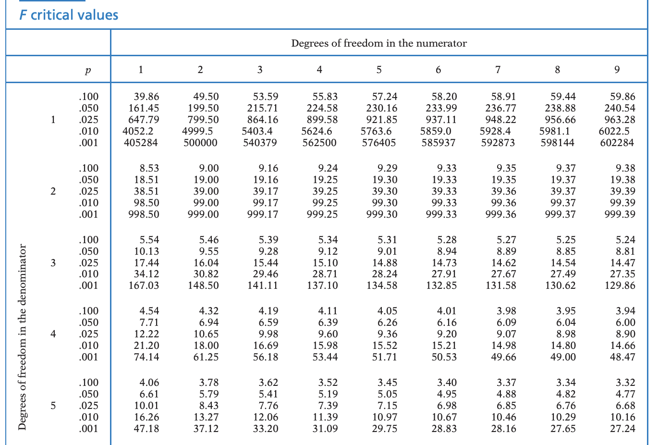
Evaluating Overall Model Utility
https://www.omnicalculator.com/statistics/f-statistic

Slide 27
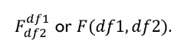
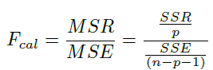
Evaluating Overall Model Utility
ANOVA test to compare several (more than two) groups’ means.
One-way: one independent variable
Two-way: two independent variable
Comparison of two models
The ANOVA table for Multiple Linear Regression
Source of Variation | DF | Sum of Squares | Mean Square | F-Statistic
Regression | p | SSR | MSR | MSR/MSE
Residual | n-p-1 | SSE | MSE
Total | n-1 | SST

Slide 28
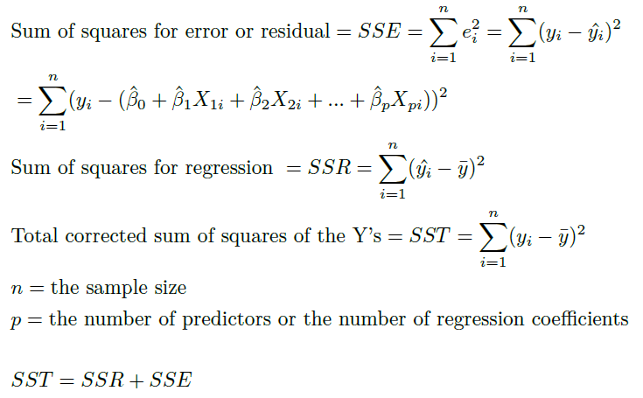
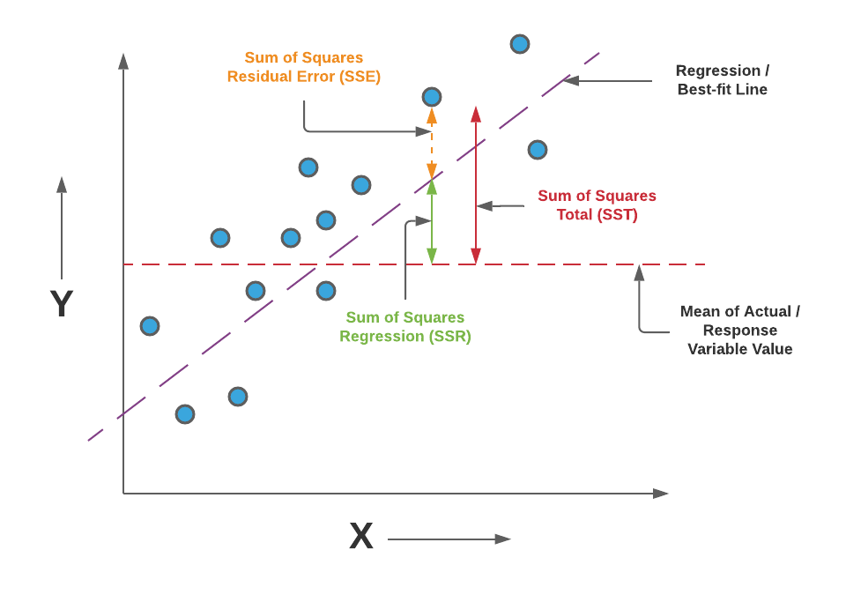
Evaluating Overall Model Utility
The larger sample variance always goes in the numerator to make the right-tailed test, and the right-tailed tests are always easy to calculate.

Slide 29
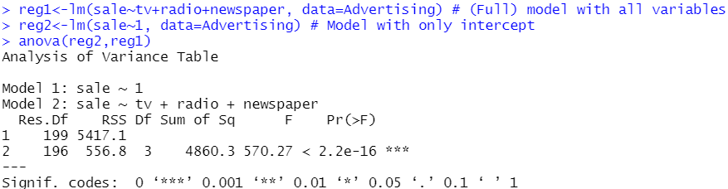
Evaluating Overall Model Utility
The ANOVA table for Advertising data example
Source of Variation | DF | Sum of Squares | Mean Square | F-Statistic
Regression | 3 | 4860.3 | 1620.1 | 570.295
Residual | 196 | 556.8 | 2.84081
Total | 199 | 5417.1

Slide 30
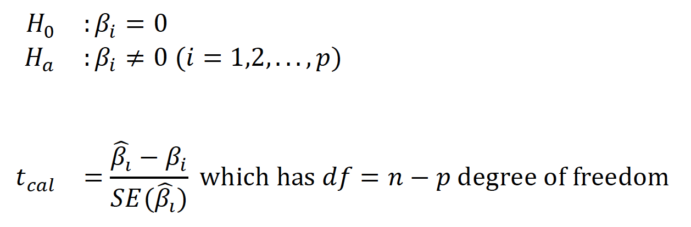
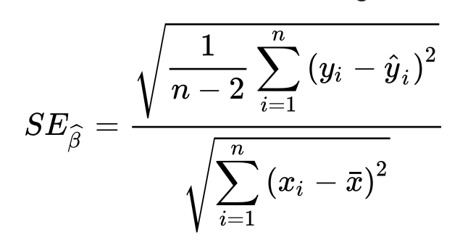
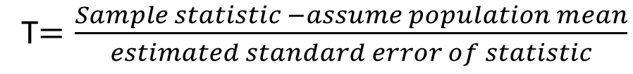
Evaluating effect of subset of predictors
2. Do all the predictors help to explain Y , or is only a subset of the predictors useful?
T-test, identify the effect of each individual predictor
T$=\frac{Sample statistic −assume population mean}{estimated standard error of statistic}$

Slide 31
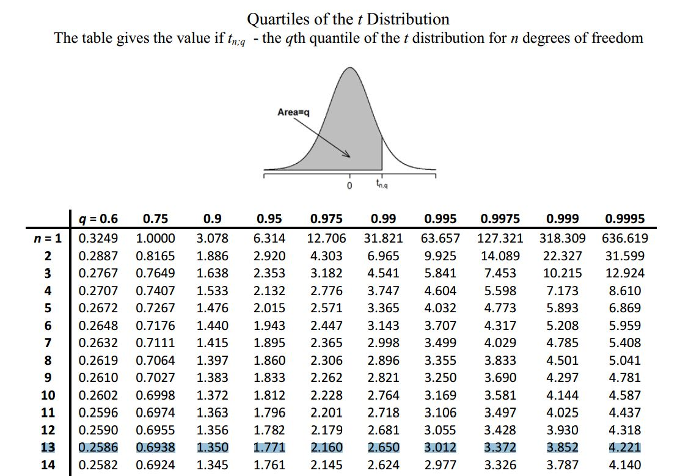
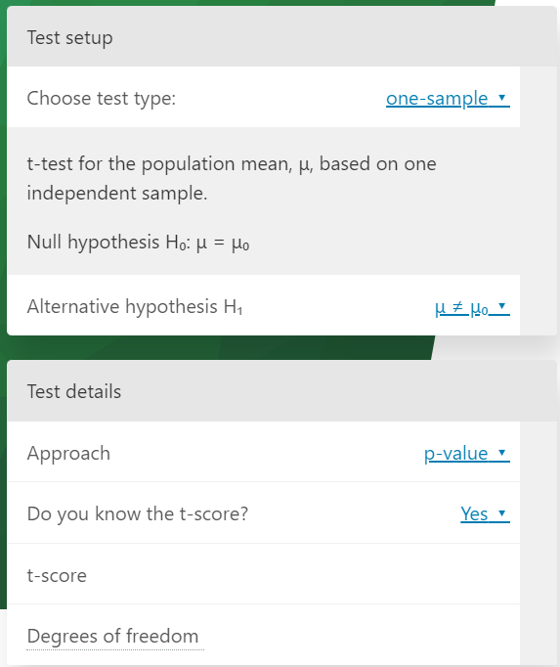
Evaluating effect of subset of predictors
https://www.omnicalculator.com/statistics/t-test

Slide 32
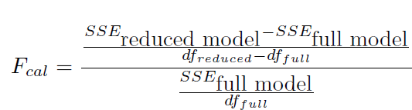
Evaluating effect of subset of predictors
2. Do all the predictors help to explain Y , or is only a subset of the predictors useful?
Partial F-test, identify the usefulness of a subset of predictors

Slide 33
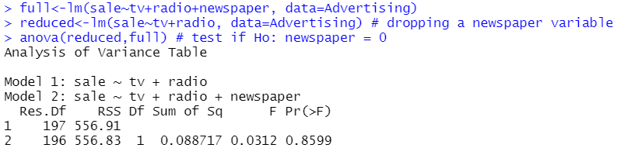
Evaluating effect of subset of predictors
With df=1,196 (p-value=0.8599 > α = 0.05 ), indicating that we should clearly not to reject the null hypothesis which mean that we can definitely drop the variable newspaper off the model.
At this point, from the initial estimated regression model is Sales = 2.939 + 0.046tv + 0.189radio − 0.001newspaper
After checking individual coefficients test, the final regression model is Sales = 2.92110 + 0.04575tv + 0.18799radio
The ANOVA table for Advertising models
Source of Variation | DF | Sum of Squares | Mean Square | F-Statistic
Regression | 1 | 0.088717 | 0.088717 | 0.0312
Residual | 196 | 556.83 | 2.84081
Total | 197 | 556.91

Slide 34
In class Practice Problem 2
Use the condominium data (condominium.csv)
Use the method of Partial F test to fit the model.
How many possible fitted models would you suggest for predictive purposes?

Slide 35

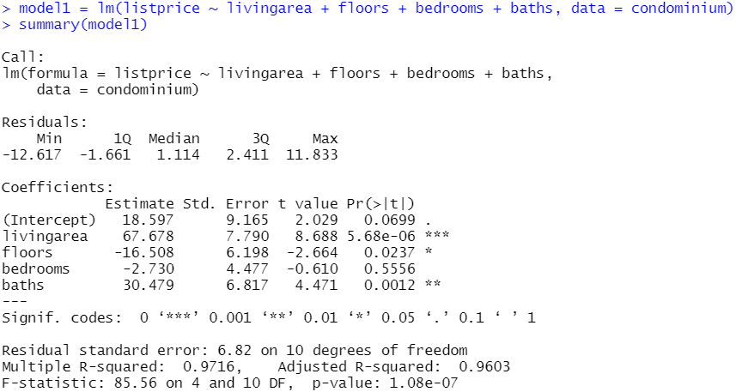
In class Practice Problem 2

Slide 36
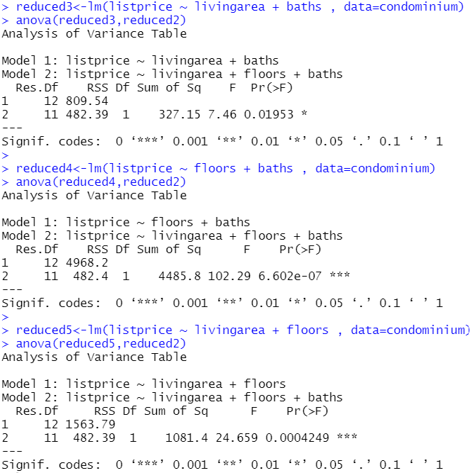
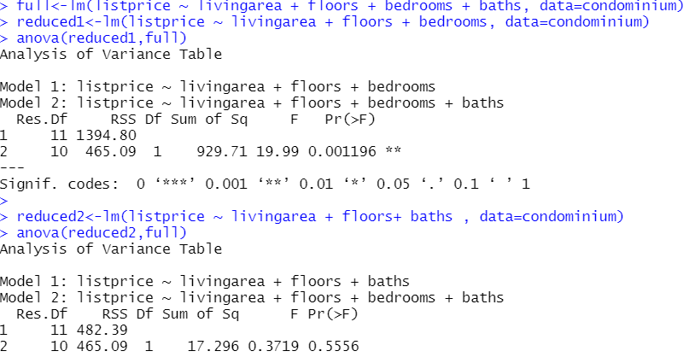
In class Practice Problem 2
>>Drop floors
Partial F-test
>>Drop living area
>>Drop baths
>>Drop baths
>>Drop bedrooms

Slide 37
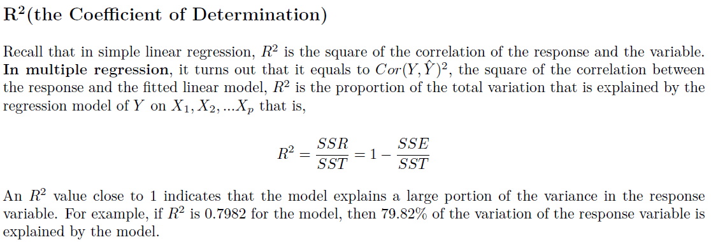
Model goodness of fit
How well does the regression model fit?? Two of the most common numerical measures of model fit are RSE(Residual Standard Error: s) and R2 (Coefficient of Determination), the fraction of variation explained. These quantities are computed and interpreted in the same fashion as for simple linear regression.

Slide 38


Model goodness of fit

Slide 39


Model goodness of fit

Slide 40

Model prediction
Once we have fit the multiple regression model, it is straightforward to predict the response Y on the basis of a set of values for the predictors X1,X2, ...Xp. We usually use a prediction interval to predict the response y
The 95% confidence interval of the sale with the given parameters is between 12.5042 (thousand units)and 19.1597(thousand units) when the TV and Radio advertising budgets are 200 thousand dollars and 20 thousand dollars, respectively.

Slide 41
In class Practice Problem 3
Use the condominium data
Use the method of Model Fit to calculate R2adj and RMSE for all possible models.
Which model or set of models would you suggest for predictive purposes?
Provide the 95% condominium list price prediction interval for your dream house.

Slide 42

In class Practice Problem 3

Slide 43


Take away messages
Statistics:
General linear model/Generalized linear model
Least square method to estimate parameters
Model utility (F-test, ANOVA)
Model goodness of fit: $R^{2}, R_{adj}^{2}, MSE$
Model prediction
Code:
lm(); glm(); summary(); coefficients(); confint(); anova(); predict();

Slide 44

Thank you
Questions OR Comments?
Slack channel: section2-course-documents
Email: qing.li2@uclagary.ca

Slide 45


Logistic regression parameter estimation

